Slide 1
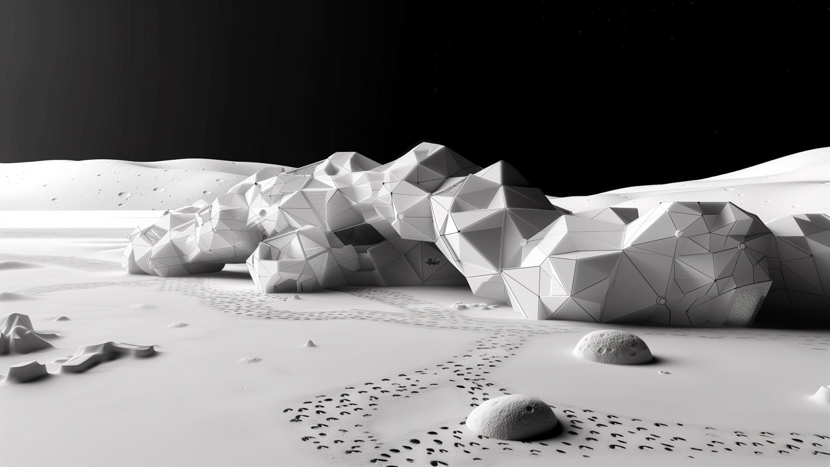
ANALYSIS.
G R O U P I V
Max Friedmann | Victor Lopez Lefterov | Lilian Le | Antonia Sattler | Lowie Swinkels

Slide 2
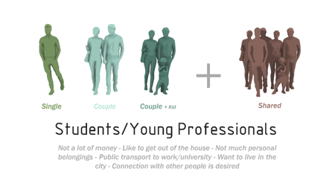
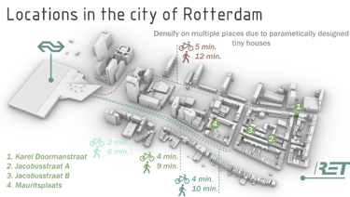
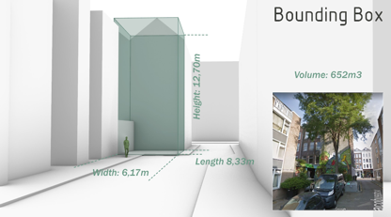
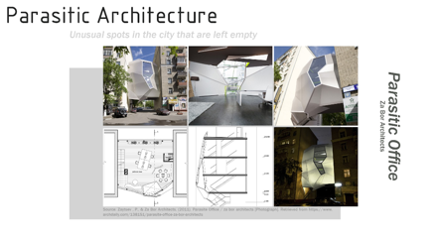
C A S E S T U D Y A N A L Y S I S
CHALLENGES
Student housing crisis in Rotterdam
Non-adaptive construction industry
Linear economy vs. circular economy
DESIGN QUESTION
How can the inner city be densified by filling in empty building plots using innovative construction techniques like the 3D printer?
RESEARCH QUESTION
How can this building be 3D printed with renewable, natural and fewest materials – and sourced as locally as possible?

Slide 3
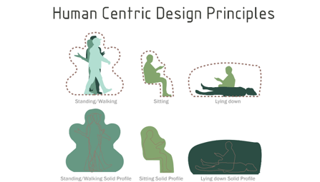
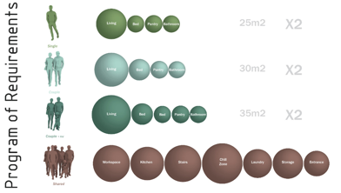
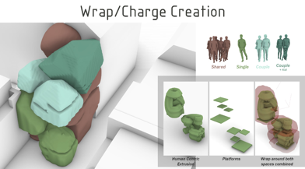
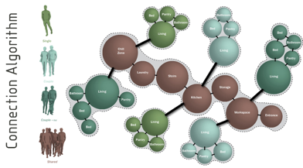
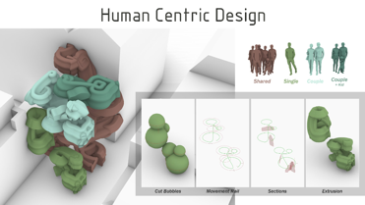
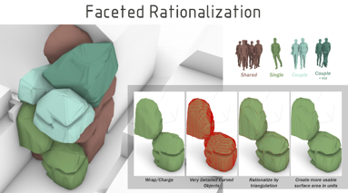
I N T E R I O R D E S I G N

Slide 4
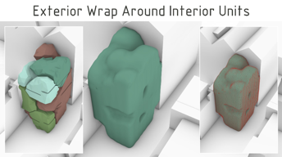
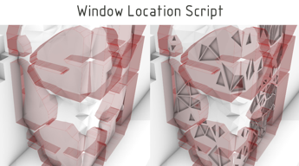
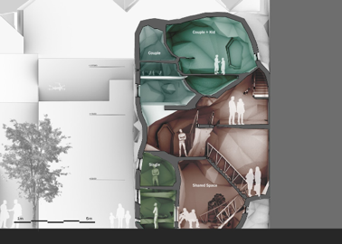
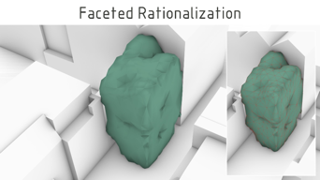
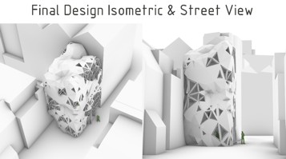
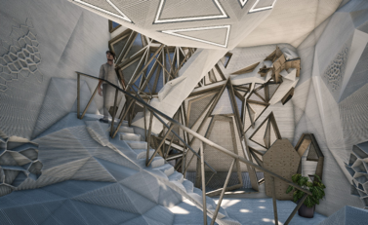
E X T E R I O R D E S I G N
V I S U A L I S A T I O N

Slide 5
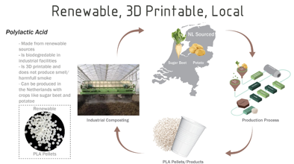
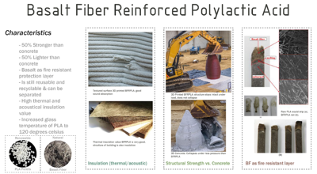
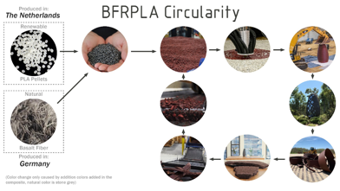
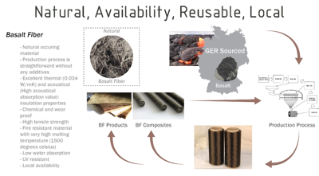
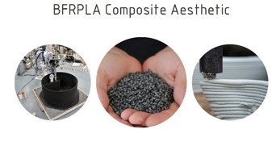
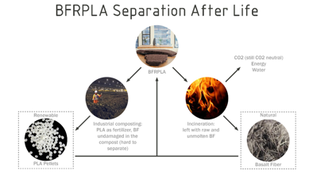
M A T E R I A L I S A T I O N

Slide 6
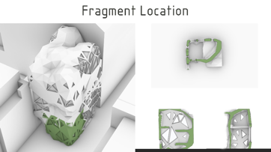
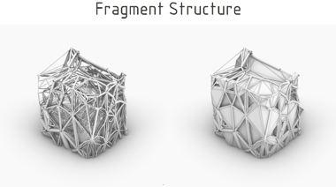
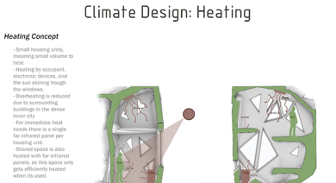
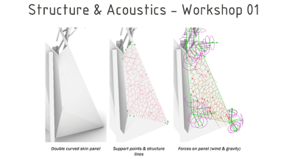
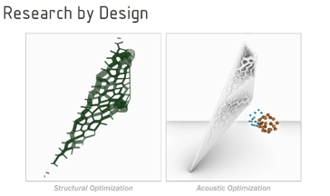
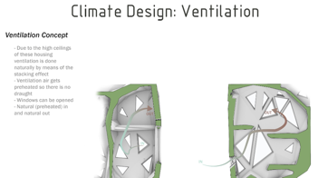
F R A G M E N T

Slide 7
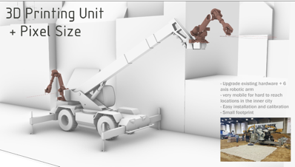
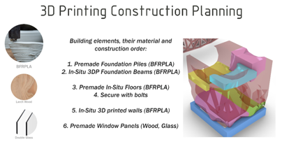
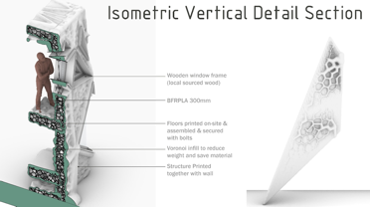
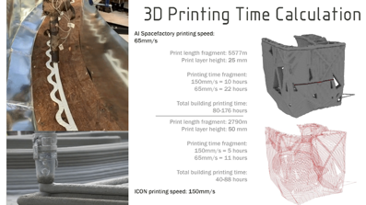
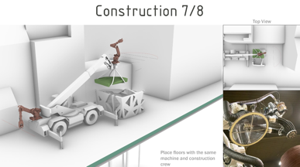
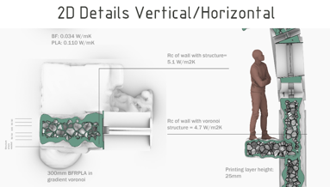
O N – S I T E C O N S T R U C T I O N
D E T A I L

Slide 8
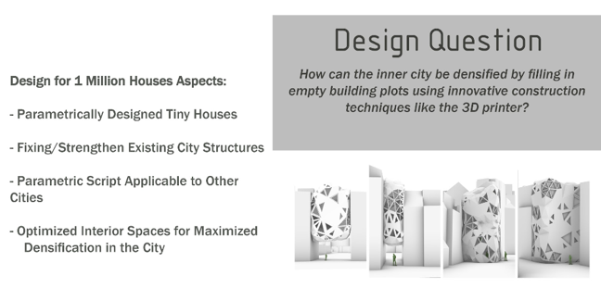
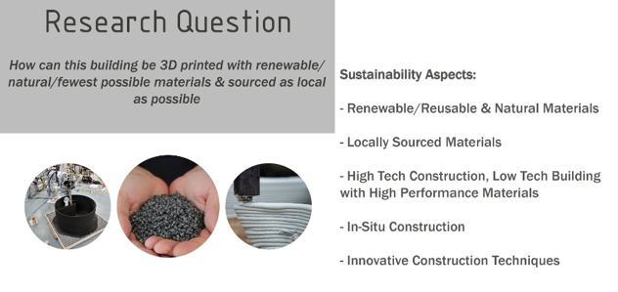
C O N C L U S I O N

Slide 9
JOURNEY
TO THE
M O O N .
G R O U P I V
Max Friedmann | Victor Lopez Lefterov | Lilian Le | Antonia Sattler | Lowie Swinkels

Slide 10
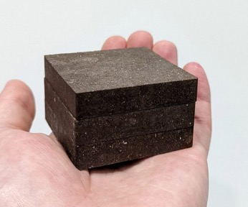
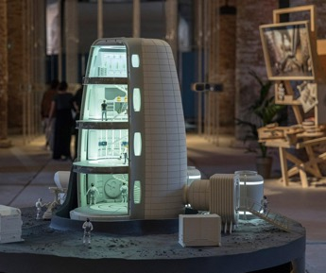
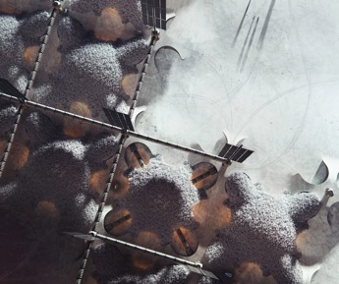
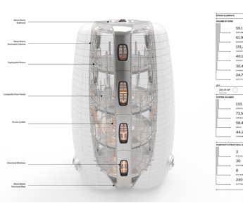
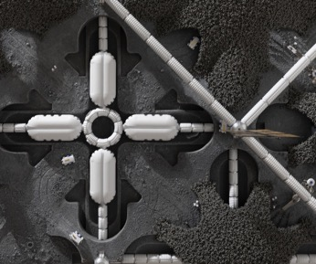
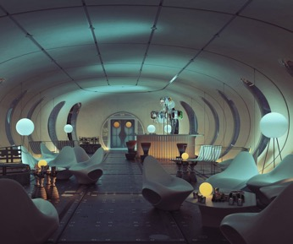

Slide 11
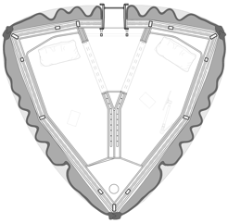
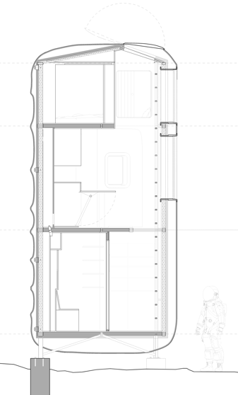
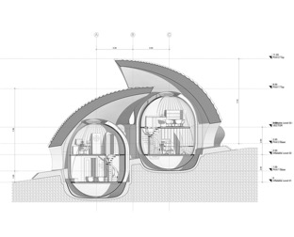
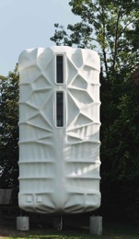
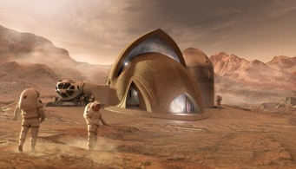

Slide 12
C O N C E P T U A L D E S I G N
DESIGNING THE PROCESS
MOON LANDER/
FIRST SHELTER
CENTER OF THE BASE/ START OF MISSION

Slide 13
C O N C E P T U A L D E S I G N
DESIGNING THE PROCESS
WHICH ADDITIONS HAVE TO COME FIRST?
HOW MUCH SPACE DO THEY NEED?
HOW MUCH TIME WILL BE SPENT IN THE ROOMS?
HOW MUCH SECURITY? UNDERGROUND? SHELL?
IS THERE ANY RISK COMING FROM THE ROOM ITSELF?
WHICH ROOMS NEED TO BE CONNECTED?
WHICH TECHNICAL INFRASTRUCTURE IS NECESSARY?
MOON LANDER/
FIRST SHELTER
TRANSLATION INTO SCRIPT

Slide 14
C O N C E P T U A L D E S I G N
DESIGNING THE PROCESS
1.
WHICH ADDITIONS HAVE TO COME FIRST?
HOW MUCH SPACE DO THEY NEED?
HOW MUCH TIME WILL BE SPENT IN THE ROOMS?
HOW MUCH SECURITY? UNDERGROUND? SHELL?
IS THERE ANY RISK COMING FROM THE ROOM ITSELF?
WHICH ROOMS NEED TO BE CONNECTED?
WHICH TECHNICAL INFRASTRUCTURE IS NECESSARY?
MOON LANDER/
FIRST SHELTER

Slide 15
C O N C E P T U A L D E S I G N
DESIGNING THE PROCESS
WHICH ADDITIONS HAVE TO COME FIRST?
HOW MUCH SPACE DO THEY NEED?
HOW MUCH TIME WILL BE SPENT IN THE ROOMS?
HOW MUCH SECURITY? UNDERGROUND? SHELL?
IS THERE ANY RISK COMING FROM THE ROOM ITSELF?
WHICH ROOMS NEED TO BE CONNECTED?
WHICH TECHNICAL INFRASTRUCTURE IS NECESSARY?
20qm
MOON LANDER/
FIRST SHELTER

Slide 16
C O N C E P T U A L D E S I G N
DESIGNING THE PROCESS
WHICH ADDITIONS HAVE TO COME FIRST?
HOW MUCH SPACE DO THEY NEED?
HOW MUCH TIME WILL BE SPENT IN THE ROOMS?
HOW MUCH SECURITY? UNDERGROUND? SHELL?
IS THERE ANY RISK COMING FROM THE ROOM ITSELF?
WHICH ROOMS NEED TO BE CONNECTED?
WHICH TECHNICAL INFRASTRUCTURE IS NECESSARY?
-5.0m
MOON LANDER/
FIRST SHELTER

Slide 17

C O N C E P T U A L D E S I G N
DESIGNING THE PROCESS
!
WHICH ADDITIONS HAVE TO COME FIRST?
HOW MUCH SPACE DO THEY NEED?
HOW MUCH TIME WILL BE SPENT IN THE ROOMS?
HOW MUCH SECURITY? UNDERGROUND? SHELL?
IS THERE ANY RISK COMING FROM THE ROOM ITSELF?
WHICH ROOMS NEED TO BE CONNECTED?
WHICH TECHNICAL INFRASTRUCTURE IS NECESSARY?
MOON LANDER/
FIRST SHELTER

Slide 18
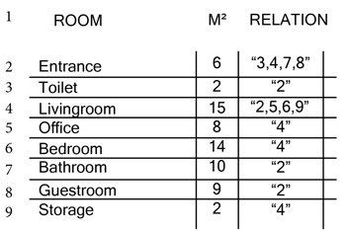
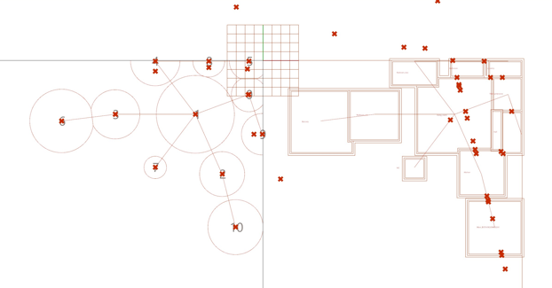
S C R I P T E X P E R I M E N T A T I O N
I N P U T
O U T P U T

Slide 19


A T T R A C T I O N S P O I N T S

Slide 20


L I F E S U P P O R T
S Y S T E M I N T E G R A T I O N
A R C H I T E C T U R E | F A B R I C A T I O N
Space-demand in the habitat
How many habitat-modules can be supplied by one LSS
Integration of pipes and wires (airtight interface)
Integration in the 3d Printing process
Connection of different modules
Airtight-layers in addition to 3d print and airlocks (e.g. light membrane made from TPU or Mylar)
Lasseur, C., Brunet, J., De Weever, H., Dixon, M., Dussap, G., Godia, F., ... & Van Der Straeten, D. (2010). MELiSSA: the European project of closed life support system. Gravitational and Space Research, 23(2).

Slide 21






C O M M U N I C A T I O N
Communication between the different habitat-modules and between the different LSSs
Mod 1
Mod 2
U S A G E
Energy-efficient operation
Individual configuration
Greenhouse add-on
Eriksson, K., Doule, O., & Poulet, L. (2014). Architectural concepts for a lunar greenhouse within the MELiSSA framework.

Slide 22






A I - V I S U A L I S A T I O N

Slide 23


